Slide 1
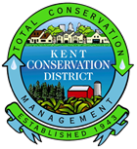
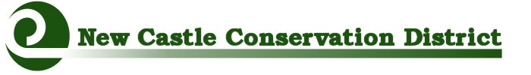
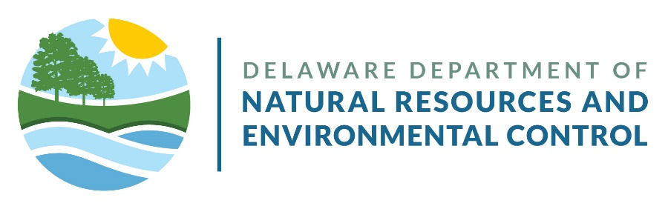
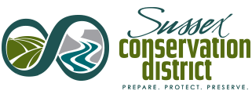
Drainage Assistance
A Conservation Partnership
Legislative Staff Briefing
October 19, 2023
Notes:
Introductions:
Robert Palmer: Acting Director Division of Watershed Stewardship
Brooks Cahall: Drainage Program Manager
Kevin Donnelly: District Coordinator for NCCD

Slide 2
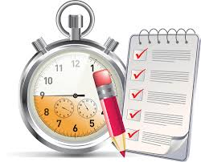
Agenda
Introductions
General Conservation District Information
Programmatic Round Table Discussion
  Resource, Conservation, & Development Program Implementation
  County Specific Programs
Questions and Answers

Slide 3
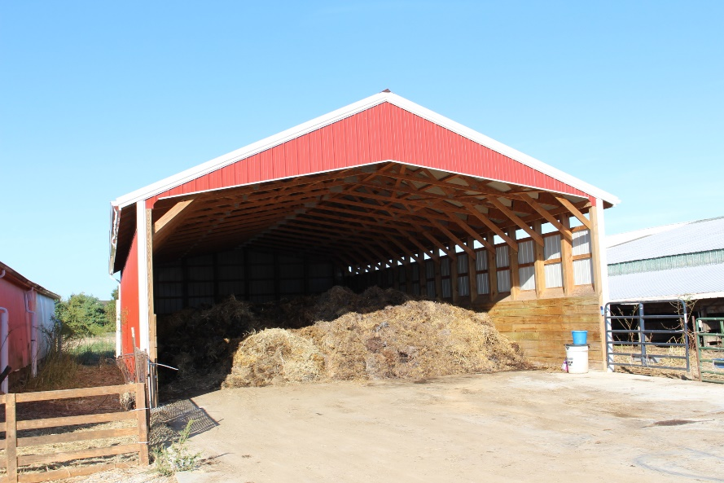
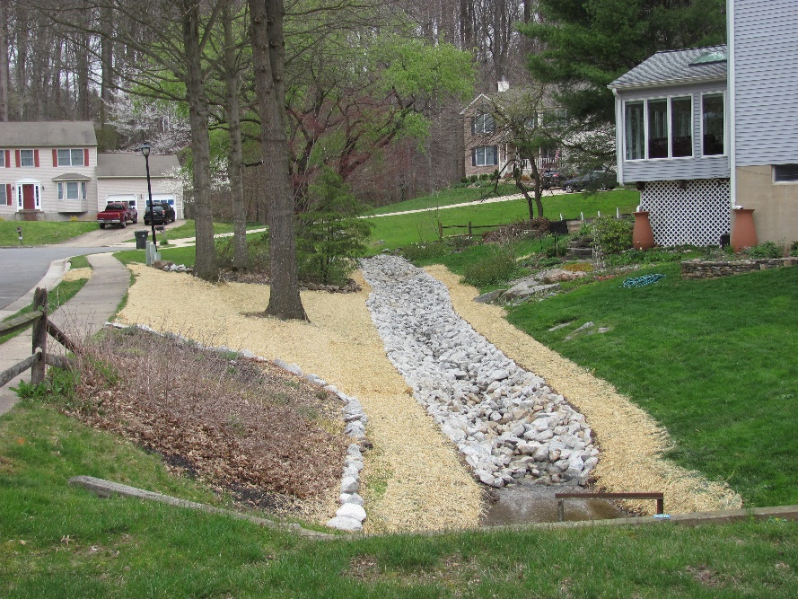
Delaware’s 3 Conservation Districts
Established in the 1940’s under Title 7, Del. C., Chapter 39
Possess broad powers in conserving and protecting land and water resources and carrying out measures to reduce & prevent erosion, flood waters and sediment damages.
Districts can work on private property and work/cooperate with any entity
  Private landowners
  Home-owner associations
  Communities
  Corporations and businesses
  Government agencies
  Non-profits
Animal Waste Storage Shed
Drainage Swale

Slide 4
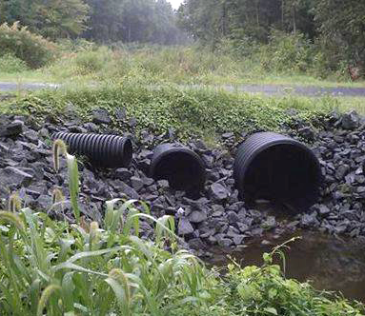
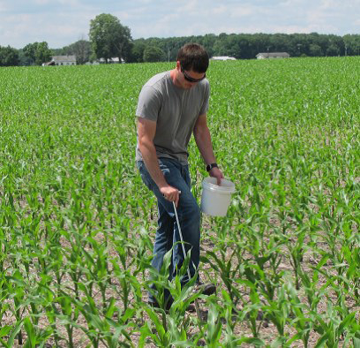
Delaware’s 3 Conservation Districts
Directed by Board of Supervisors in each county
  Board Members are Elected & Appointed
  Under the administrative control of DNREC
  District Boards include representatives from:
    UD Cooperative Extension
    County governments
Have working agreements with DNREC and USDA – Natural Resources Conservation Service, and the Delaware Nutrient Management Commission
Delaware Association of Conservation Districts (DACD) is a statewide association that provides support and coordination among the three Districts
Pipe Replacement
Soil Testing

Slide 5
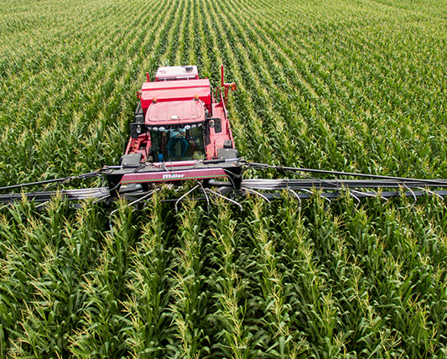
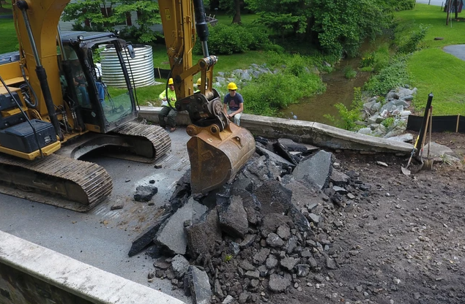
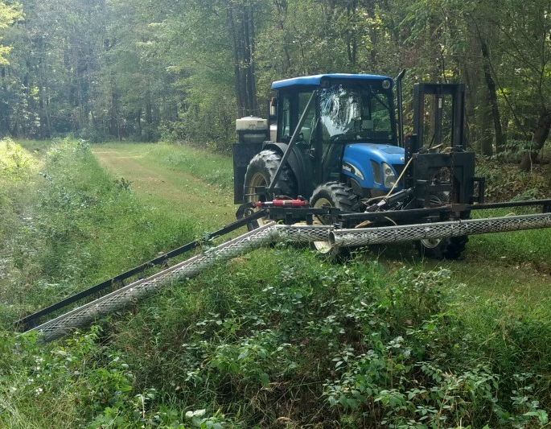
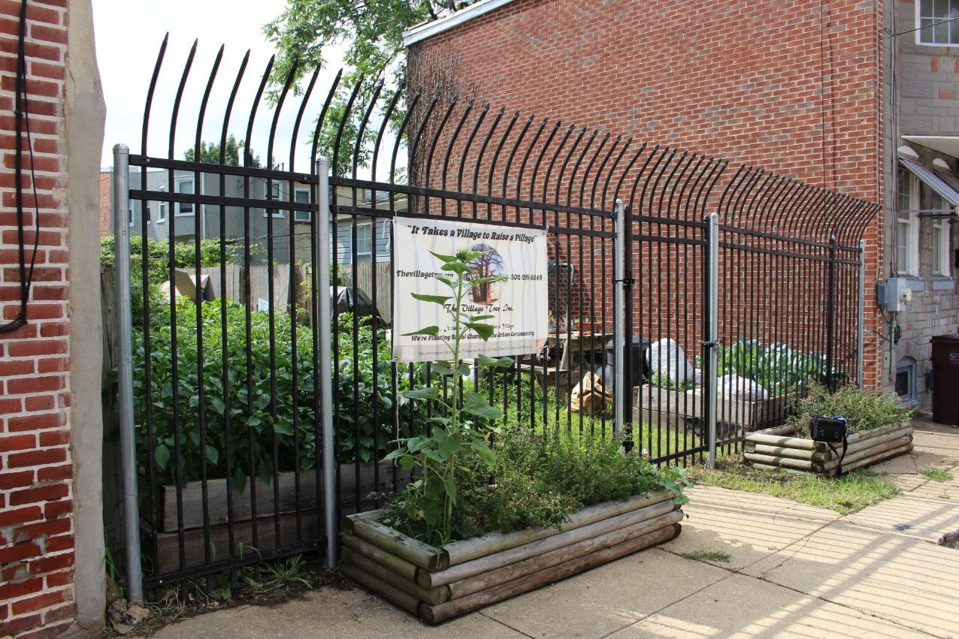
Drainage Projects ˙ Tax Ditch Maintenance and Repairs ˙ Ag Conservation ˙ Urban Ag ˙ Rain Gardens ˙ Nutrient Management Planning ˙ Stormwater Retrofits ˙ Outreach and Education ˙ Heavy Equipment Services ˙ Stormwater Plan Reviews ˙ Conservation Planning ˙ Hundreds of Projects Every Year

Slide 6
Delaware’s 3 Conservation Districts
Majority of funding comes from General Assembly’s Bond Committee through DNREC including:
FY2024 Approved Capital Budget
  Conservation Cost Share (DNREC) = $1,700,000
  Resource, Conservation & Development Funds (DNREC) = $10,000,000
  Tax Ditches (DNREC) - $2,148,000
  Cover Crop Investment (DDA) - $5,190,000
FY2024 Operating Budget
  3921 Funding – State & County provide $75k each = $150,000/District
  Conservation District Nutrient Management planners - $180,000
Each Conservation District has a DNREC approved Conservation Cost Share program
Each Conservation District works with DNREC on Tax Ditches within each County
Other funding may be provided from of grants from a different agencies and organizations.

Slide 7
Resource, Conservation, & Development Program Implementation
New Castle Conservation District
Kent & Sussex Conservation Districts
RC&D/21st Century Fund Projects are managed by NCCD
NCCD works closely with DelDOT re: legislative projects funded by CTF
Projects must appear on approved “Projects List” contained in annual RC&D/21st CF Report in order to be approved for CTF
Amount of 21st CF & CTF project specific funding varies by project.
No less than 10% of estimated project cost must be CTF. Remaining 90% can come from 21st CF (if available) or other non-state funds.
DelDOT – NCCD process for signing third party agreements & issuing the Notice to Proceed (NTP) takes time.
Multiple project steps once NTP is issued including surveying, design, obtaining access permission & landowner signatures, advertising for bids, construction, final 6-month inspection & weather impacts.
RC&D/21st Century Fund Projects are managed by DNREC – Watershed Stewardship. SCD and KCD take lead on projects assigned by DNREC.
DNREC & CDs work with DelDOT on projects funded completely or partially with CTF
Projects must appear on approved “Projects List” contained in annual RC&D/21st CF Report in order to be approved for CTF
No less than 10% of estimated project cost must be CTF. Remaining 90% can come from 21st CF (if available) or other non-state funds.
Typical projects are funded with 80% 21st CF & 20% CTF
Requests for CTF typically occur when projects are ready for construction but may be requested to fund design costs.
Projects are Multiple Steps and take time to develop. Steps include Surveying/engineering, Landowner Agreements, Permitting, and Contracting
Most projects are constructed using CD Equipment Program.

Slide 8
County Specific Programs
NCCD
Tax Ditch Cost Share (3921)
SCD
Tax Ditch Cost Share (3921)
KCD
Tax Ditch Cost Share (3921)
Stormwater Maintenance Districts
On-Farm Drainage Assistance
Conservation (Ag) Cost Share
Conservation Cost Share
Ag – Traditional and Urban
Urban\Suburban
Sussex County Drainage Cost Share Program
On-Farm Drainage Assistance
Conservation (Ag) Cost Share

Slide 9
Drainage Partnership
NCCD
Tax Ditch Cost Share (3921)
SCD
Tax Ditch Cost Share (3921)
KCD
Tax Ditch Cost Share (3921)
Stormwater Maintenance Districts
On-Farm Drainage Assistance
Conservation (Ag) Cost Share
Conservation Cost Share, including:
Ag – Traditional and Urban
Urban\Suburban
Sussex County Drainage Cost Share Program
On-Farm Drainage Assistance
Conservation (Ag) Cost Share
DNREC
Tax Ditch administrative and technical assistance
Administer the Drainage hotline
Administer RCD funding
Maintain RCD list
Maintain VOP crew

Slide 10
Questions and Answers
Who to Contact
New Castle CD
Kent CD
Kevin Donnelly
District Coordinator
Kevin.Donnelly@delaware,gov
(302) 856-8986
(302) 632-1202 cell
Tim Riley
District Coordinator
Timothy.Riley@delaware.gov
(302) 608-5370
(302) 363-4512 cell
DNREC – District Operations Program
(302) 855-1931 office
Sussex CD
David Baird
District Coordinator
david.baird@sussexconservation.org
(302) 856-2105
(302) 542-3225 cell
Tyler Brown
Conservation District Program Administrator
Tyler.Brown@delaware.gov
Melissa Hubert
Tax Ditch Manager
Melissa.Hubert@delaware.gov

